Slide 1
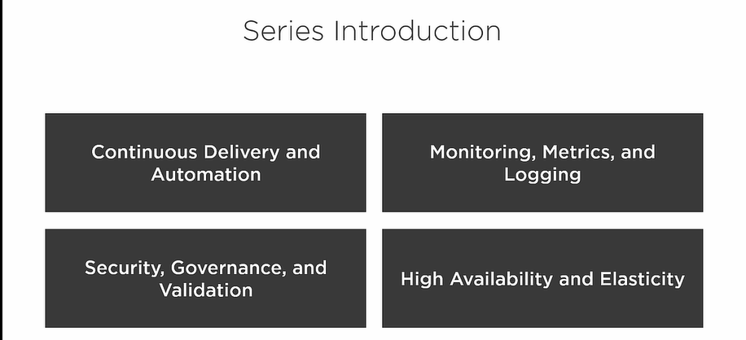
Notes:
55 %
20 %
10 %
15 %

Slide 2
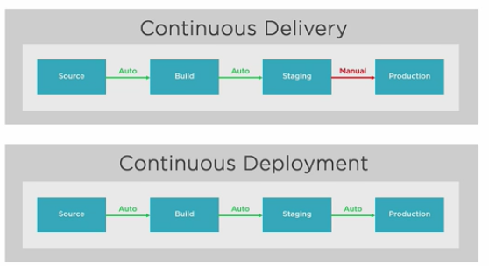

Slide 3
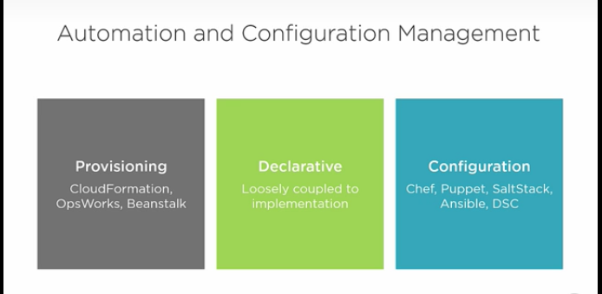

Slide 4
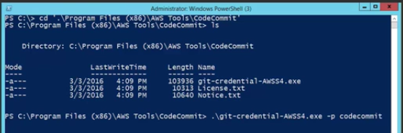
Understanding Application Lifecycle Management
Install GIT for windows
Install aws.amazon.com/powershell
In powershell ➔ Get-AWSCredentials –ListProfiles
Create a user → get his login credentials → attach code commit policy .
Set-AWSCredentials –Acceskey < > -Secretkey < > -StoreAs codecommit → cls
Notes:
Use GIT from windows command prompt
Use credential manager which comes with AWS

Slide 5
Services → developer tools → code commit → create a Myrepo
Take the http address and in power shell → git clone the copied url
Go inside cd .\Myrepo
Here git config user.email ‘<email id>’
git config user.name ‘<name>’
Create a web page → say notepad index.html → create a small we page → git status → git add index.html → git commit –m ‘initial’
→ git push origin master → changes moved to git
ri .\Myrepo –Force –Recurse
Get-history
Invoke-History <line number of the commands to run >
Use git diff <commit id > to see the change

Slide 6
Set a IAM ROLE for code deploy → choose for EC2 → Code deploy
Set Role for code deploy service → AWS Code Deploy → Code deploy
Create a Instance and assign first role → 2 instances to be launched
Use boot strap script → from git
Notes:
Github.com/mikepfeiffer → repository → aws-codedeploy-linux

Slide 7
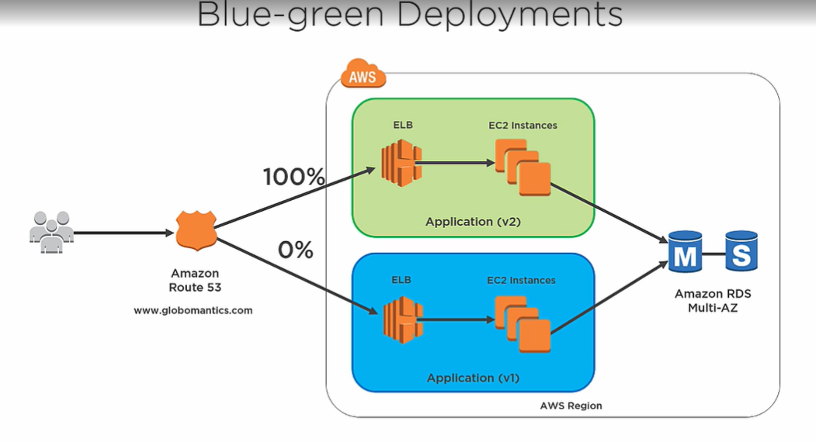
Notes:
Set low TTL for DNS records for client to prevent client cache issues .
Ensure DB schema and code changes are backward compatible .

Slide 8
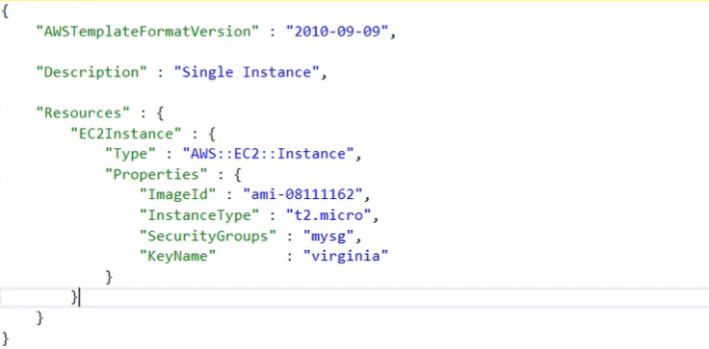

Slide 9
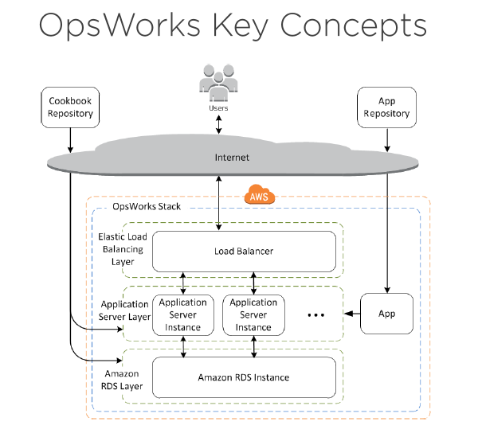
Notes:
we're going to take a look at creating stacks and managing configuration with AWS OpsWorks.
We're going to start off by talking about some of the key concepts of OpsWorks and some of the components that are included with the service. We'll see a live example of actually going through and creating a stack and setting up layers and configuring instances, and then we'll talk about some key components for the exam like life cycle events and replacing failed instances with auto-healing.
Bunch of related resources are brought together via stack ,which can be easily managed .Each layer represent a specific tier of resources and will have a ops work agent deployed on them .

Slide 10
Instance should come online
OpsWork gave the chef copybook
It executed the recipe that we wanted
Application was configured
Notes:
Management tools → ops works → add your first stack → chef 12 stack → stack anme =<…………………….> → Linux → Ubuntu 14.04 LTS → Use a existing key value pair → enable use custom chef books → https://github.com/mikepfeiffer/demo-chef-recipe.git
Advanced options → choose → EBS Backed → Create IAM Role → hostname → Layered Dependent → Add stack
Once the stack is created we add layers → add layer → in Security → choose the SG →
Recipes → custom Chef Recipes → simple_demo::default
Now we go to instances → add a new instance → Host Name → Webserver1 → T2micro →
Instead of executing chef recipe you can add a app and configure
App Name =< > paste your repository url → add App → next → deploy

Slide 11
